Slide 1
Project Step 4 Assignment: Cosmic AI with Lambda Submission
Rendezvous Server Submission
Rendezvous Server Submission
Michael Amadi and Christian Ollen

Slide 2
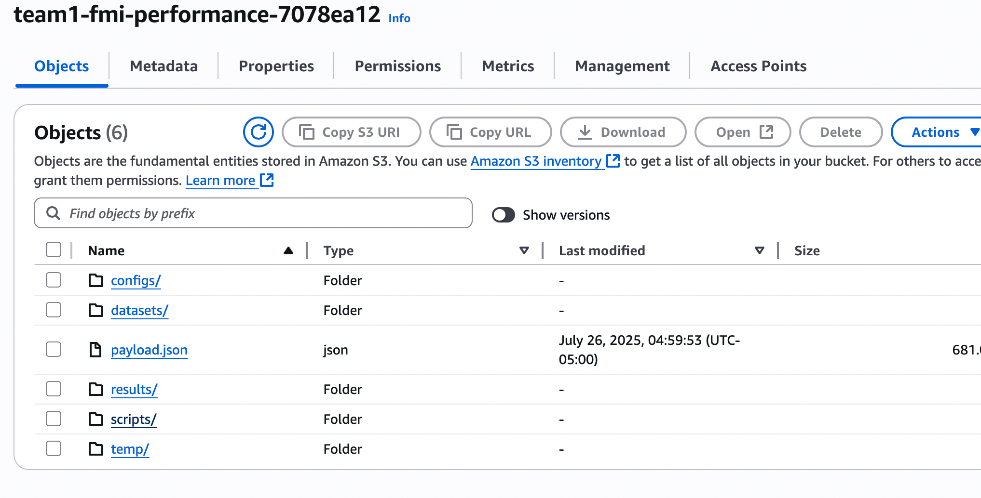
Created S3 Bucket
Created to host scripts and datasets
Bucket name: team1-fmi-performance-7078ea12, used throughout the workflow
Includes results and scripts folder required for Lambda execution

Slide 3
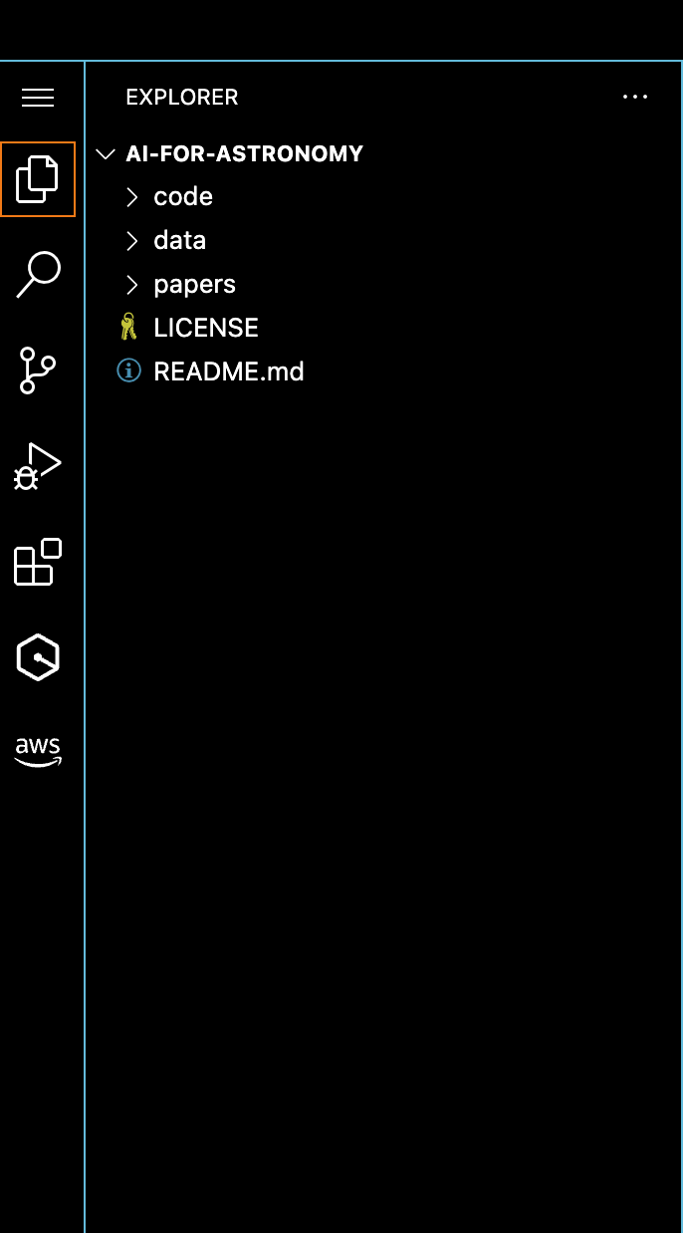
Clone repo
Includes code, data, and paper accessible in git repo `AI-FOR-ASTRONOMY`

Slide 4
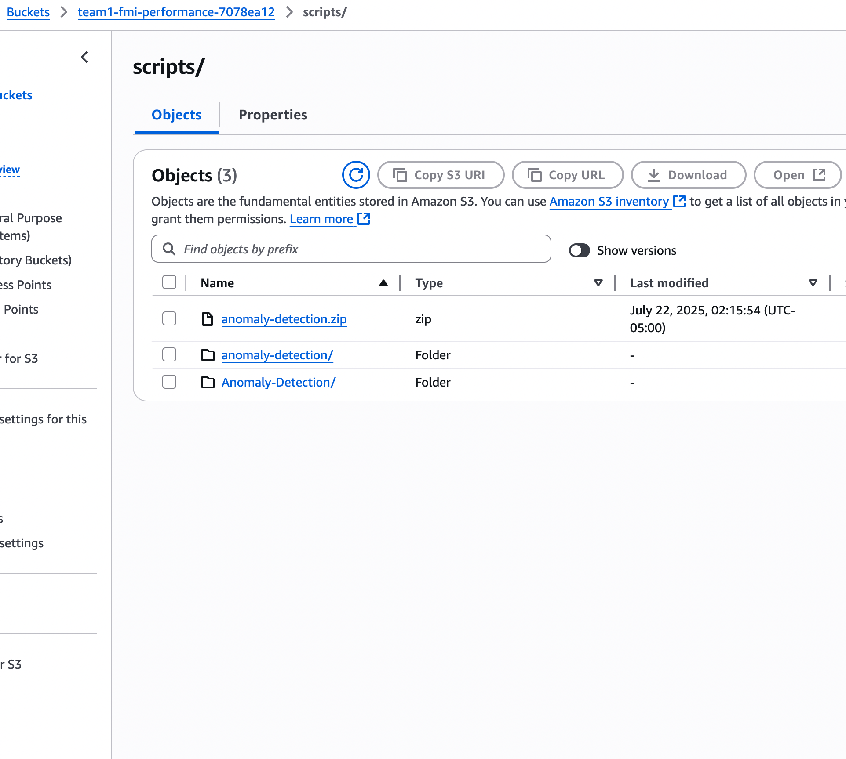
Copy folder
Copied the Anomaly Detection folder to our S3 bucket (team1-fmi-performance-7078ea12) under the scripts path; it also contains all subfolders with the scripts/ folder required

Slide 5
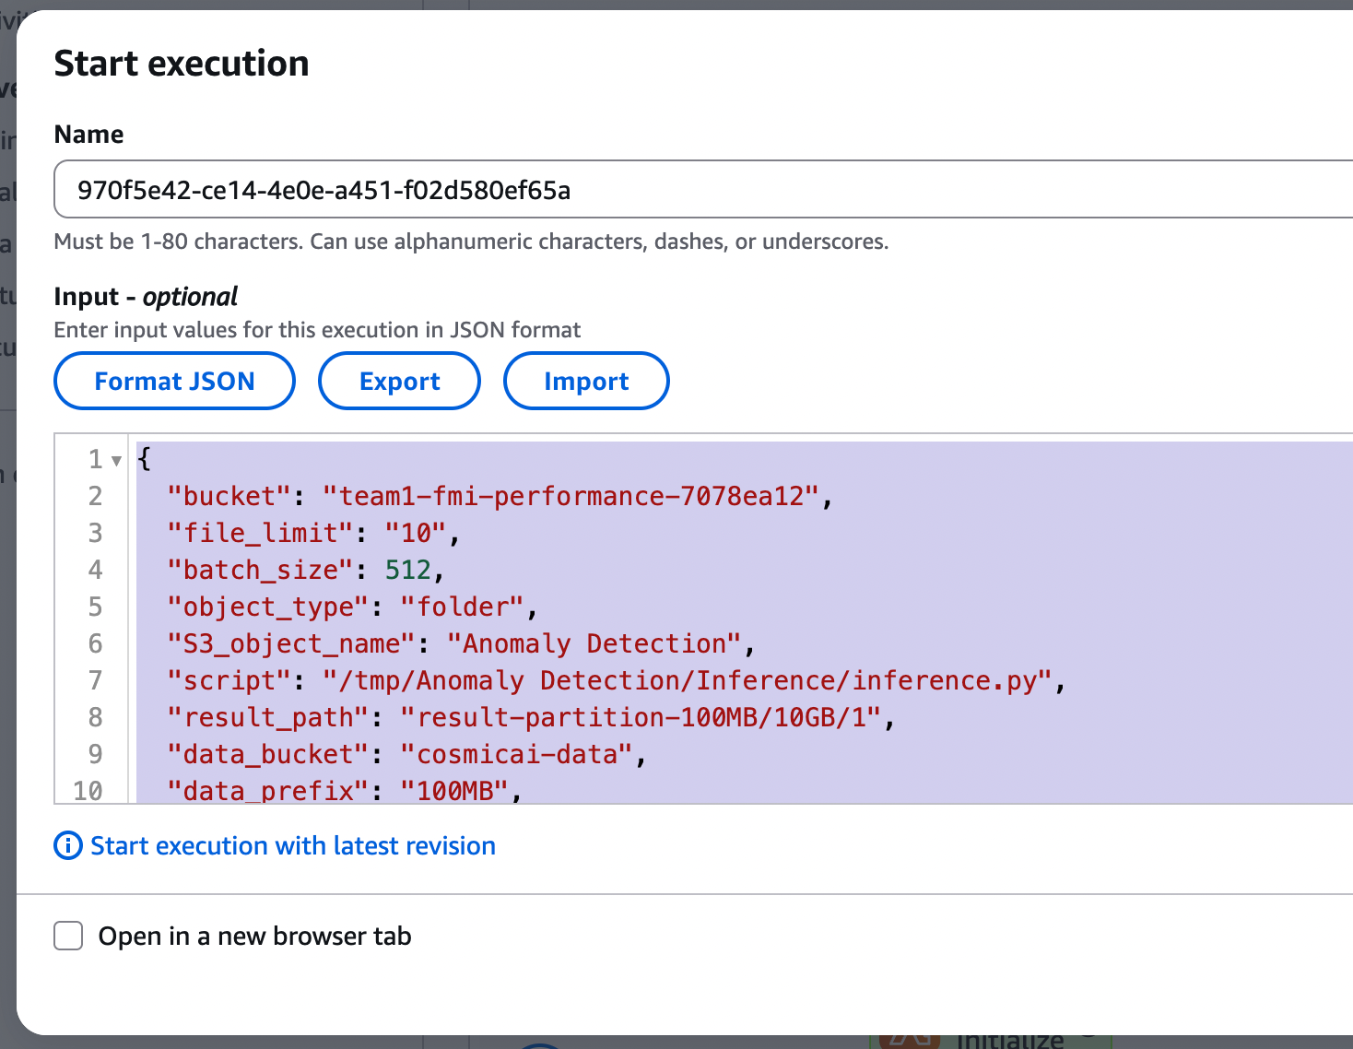
Edit payload
Updating parameters (e.g. world_size, bucket) in CosmicAI state machine in the Lambda Init State

Slide 6
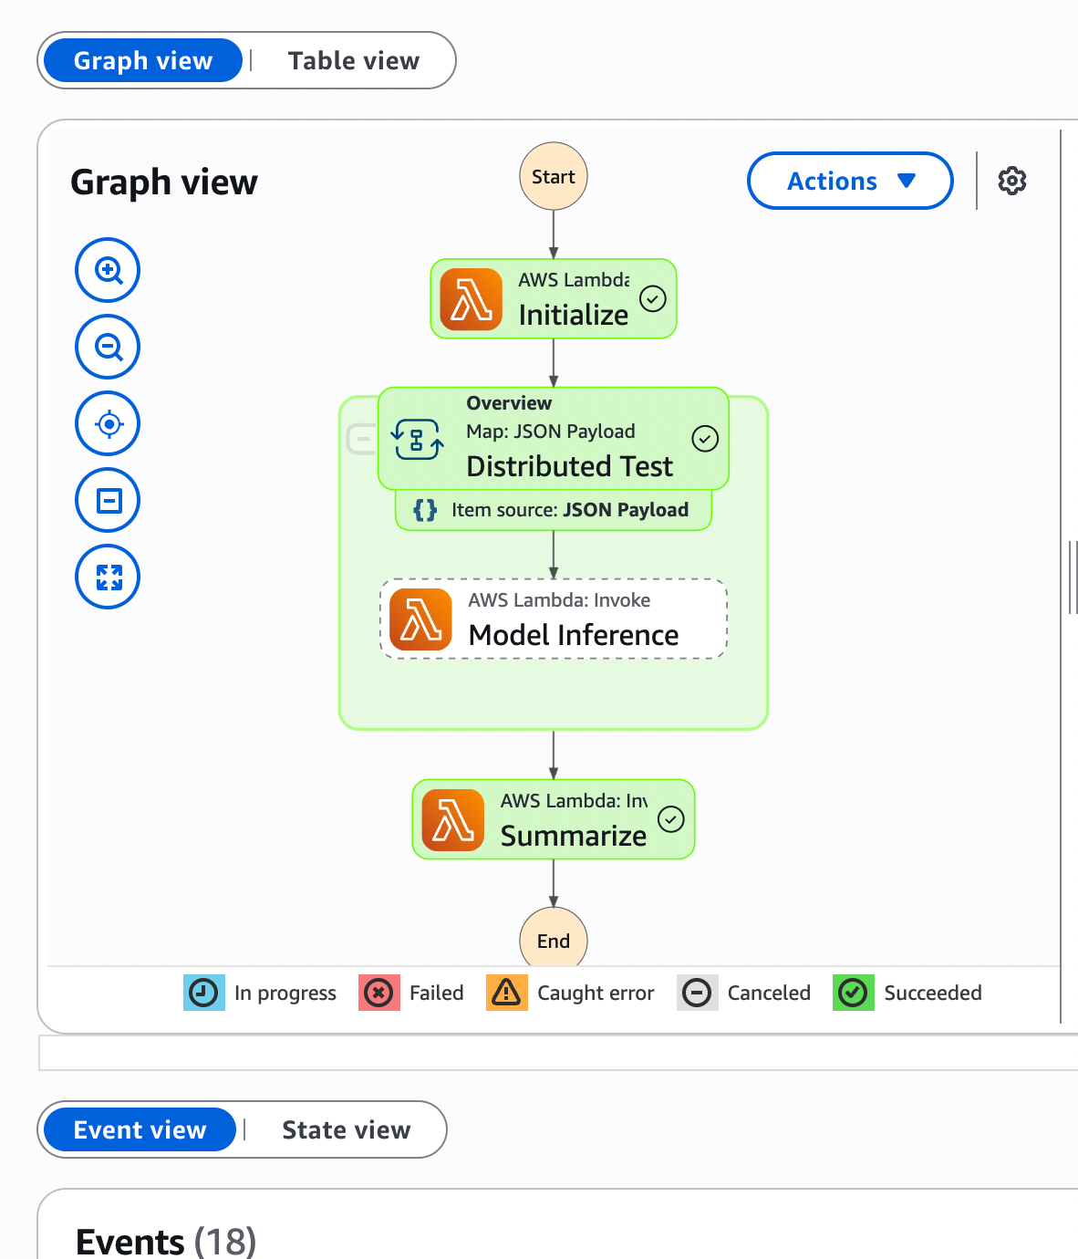
Execute Step Function
Monitor workflow in AWS Step Functions, ensuring tasks transition through all states
Workflow executed successfully with payload flowing through all Lambda states

Slide 7
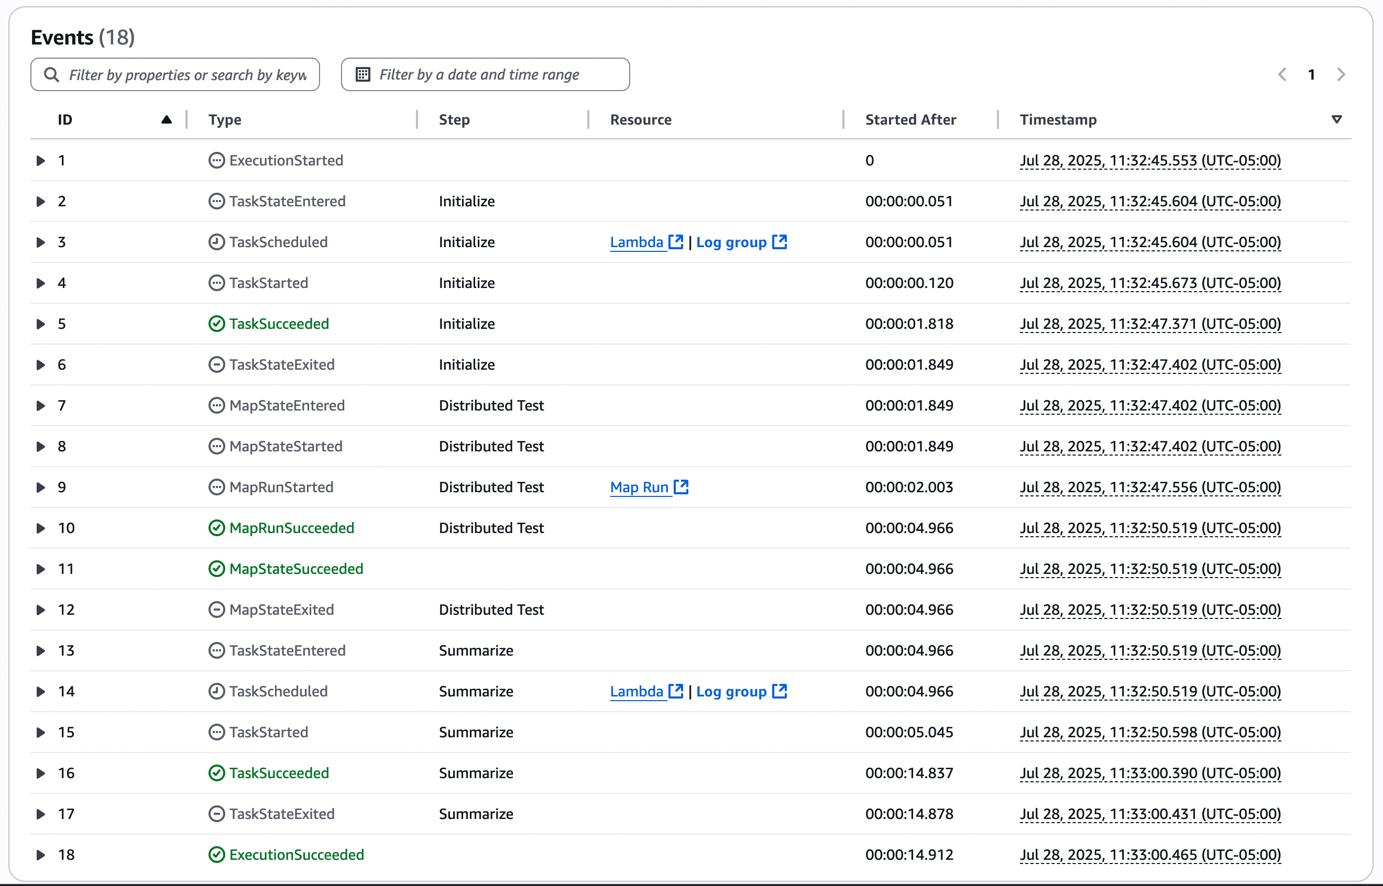
Execute Step Function
Monitor workflow in AWS Step Functions, ensuring tasks transition through all states

Slide 8
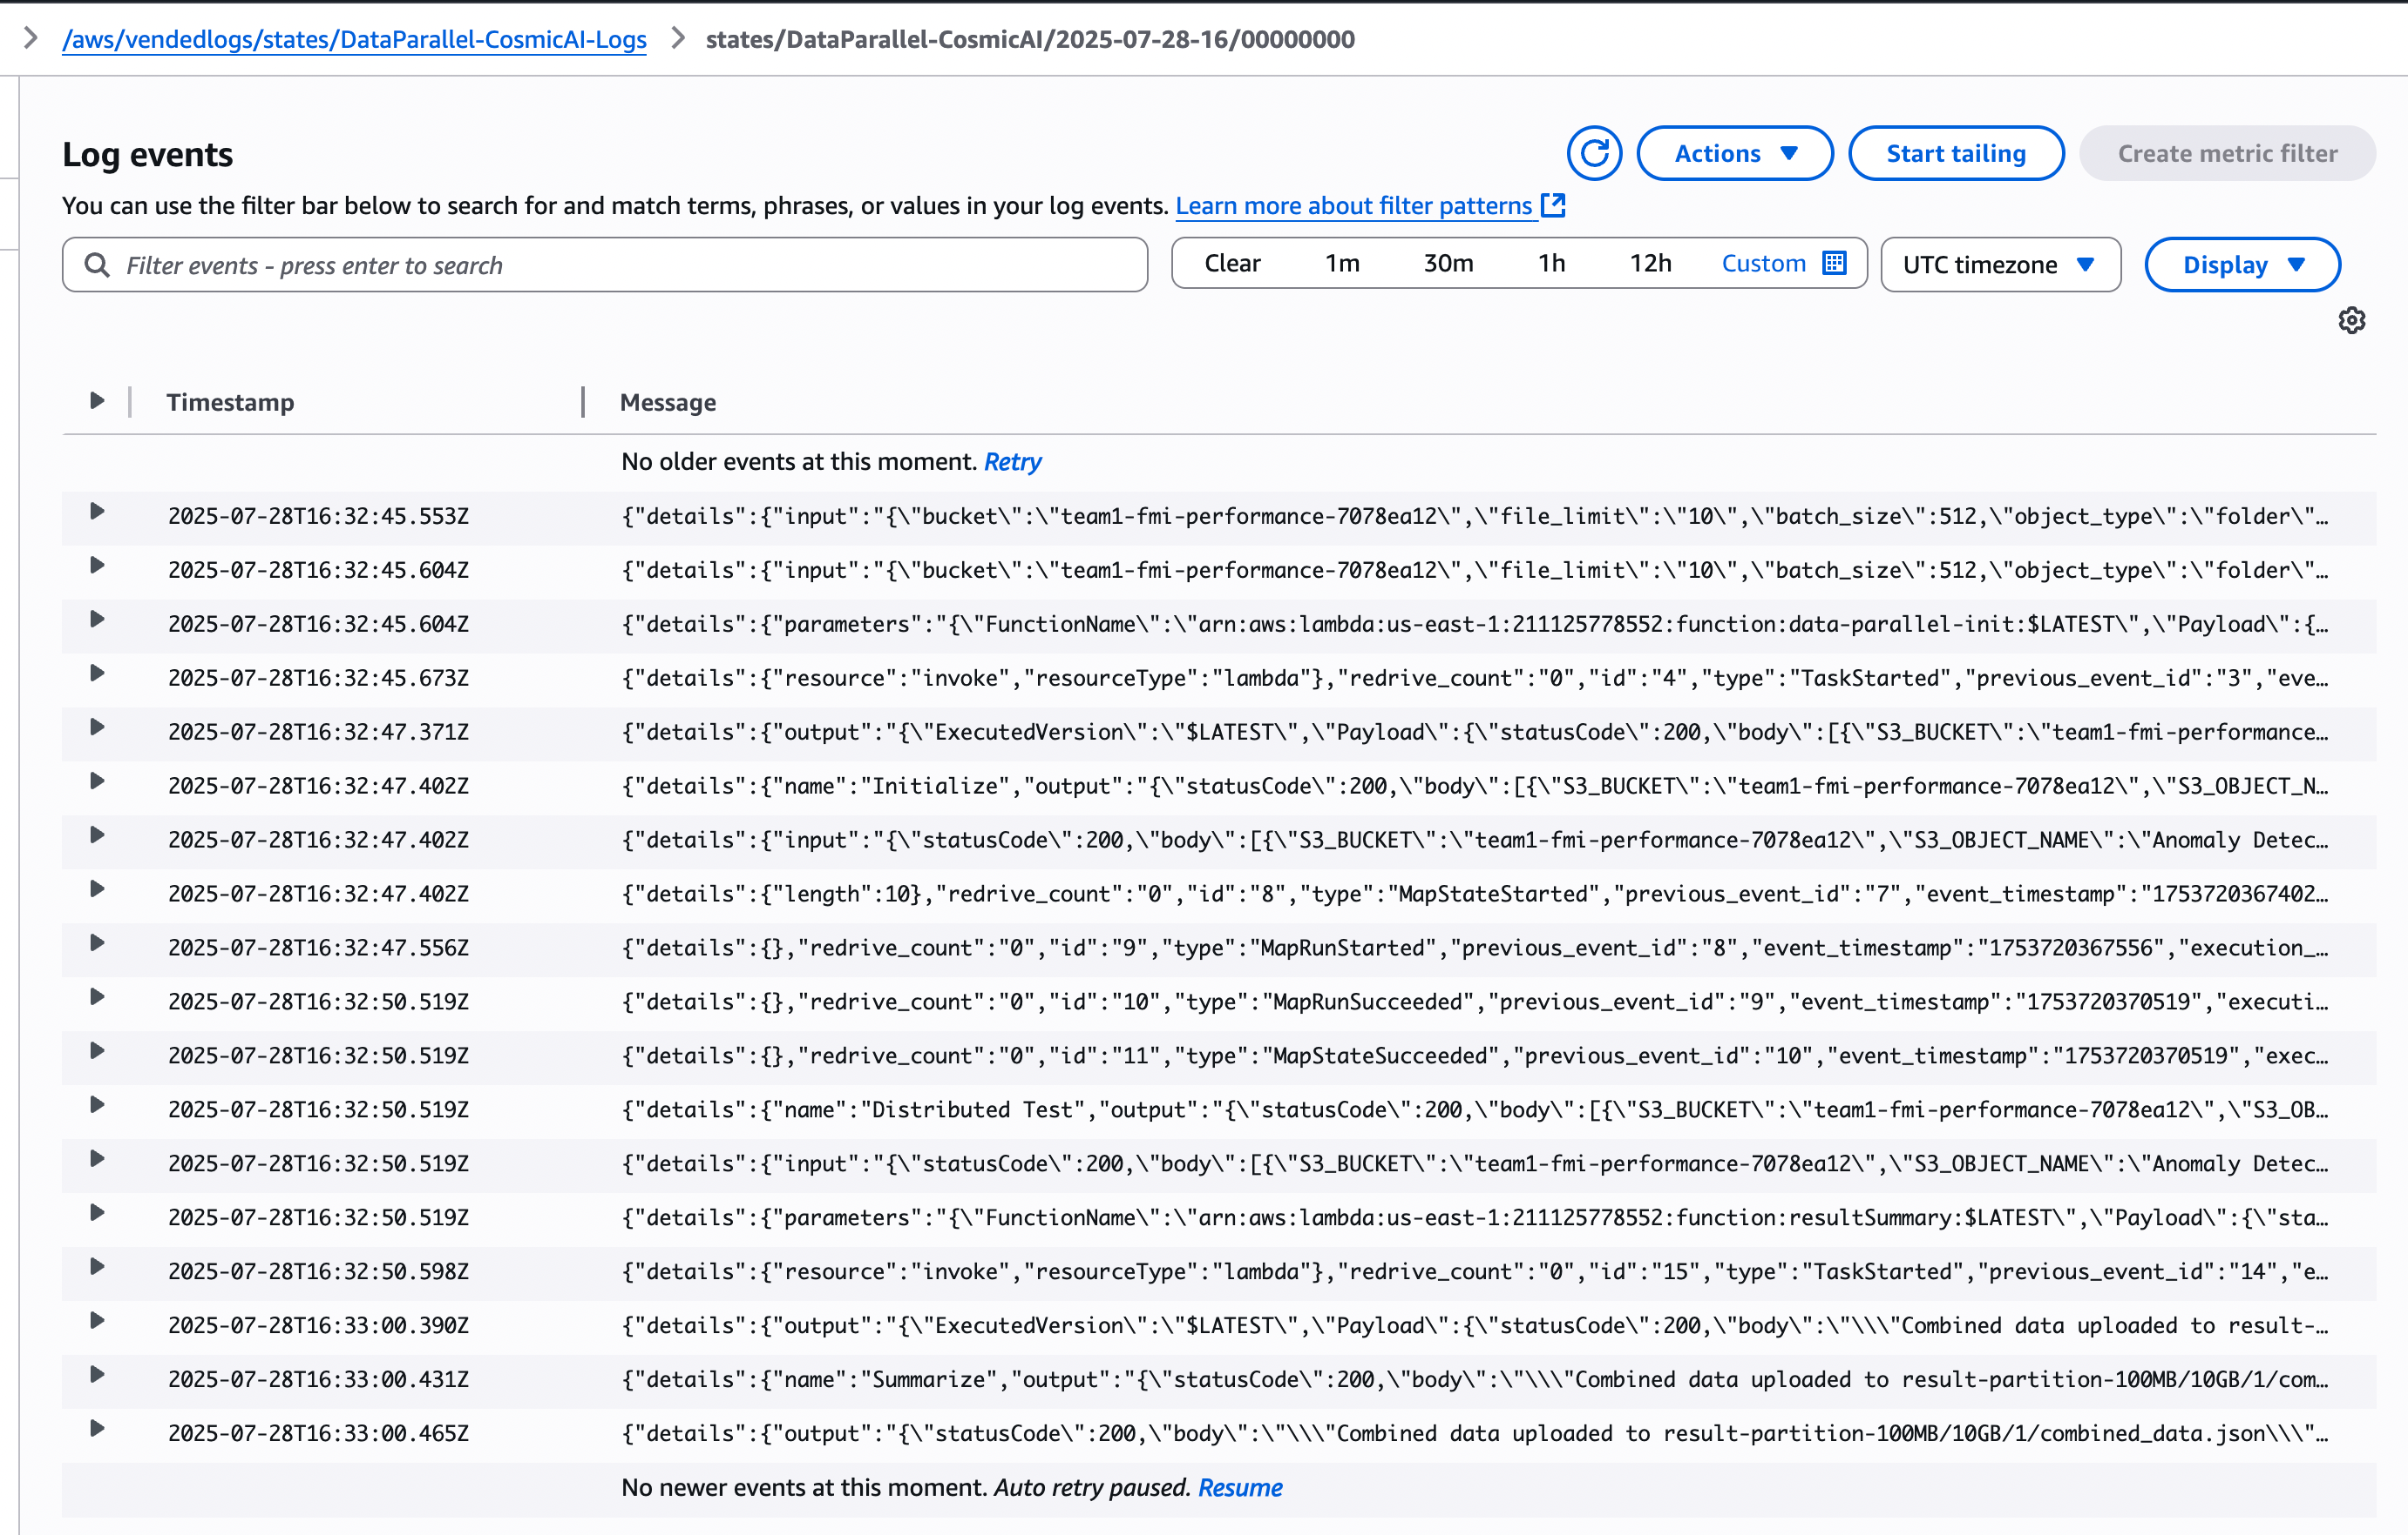
Review Logs and Results
Access CloudWatch logs to analyze execution time and memory usage
Examined log entries for task duration and memory allocation across Lambda invocations
Logs confirmed successful request handling and no errors during inference

Slide 9
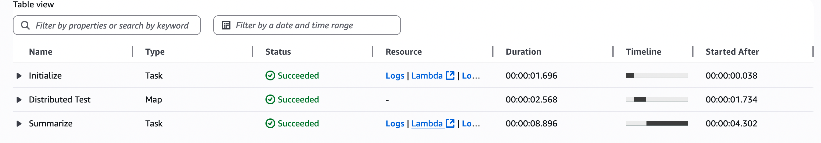
Examine the results in your S3 bucket's results folder
The distributed test phase is healthy and performant (~40 MB/s). The entire Step Functions workflow reliably completes in under 10 seconds; addressing the handful of slow shards and the long summarization step could push total runtime even lower.

Slide 10
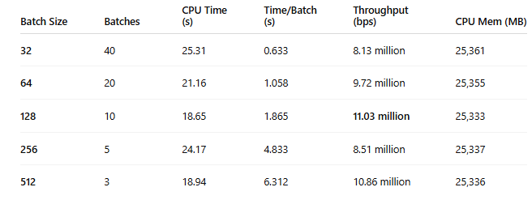
Local Inference Performance by Batch Size
All batch sizes achieved identical prediction performance (R² ≈ 0.9747, MAE ≈ 0.0125).
Batch size 128 delivered the best throughput at 11.03 million bps.
Fastest total CPU time was also with batch size 128 at 18.65 seconds.
Batch size 32 had the longest total CPU time (25.31s) despite quick per-batch speed.
Larger batches (256, 512) reduced batch count but increased time per batch and offered no accuracy gain.
Memory usage (~25.3 GB) remained nearly constant across all runs.

Slide 11
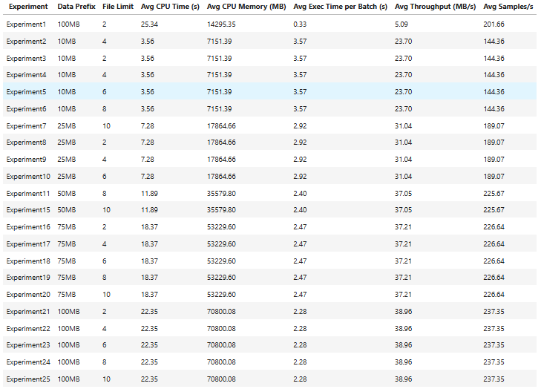
Performance Measurement
25 AWS experiments tested combinations of data prefix size (10MB–100MB) and file limits (2–10).
Performance scaled with file size: Increasing from 10MB → 100MB boosted throughput from ~23.7 MB/s to ~39 MB/s.
Larger file limits improved parallelism: File limit = 10 consistently achieved higher sample rates (up to 237.35 samples/sec).
Best throughput was achieved in Experiments 21–25 (100MB, file limit = 10), peaking at 38.96 MB/s with 2.28s batch time.
Memory scaled with input size: From 7.1 GB (10MB prefix) to ~71 GB (100MB prefix) — manageable with serverless scalability.
Results confirm Step Functions can be tuned for high-throughput, low-latency inference by optimizing data partitioning and parallel file processing.

Slide 12
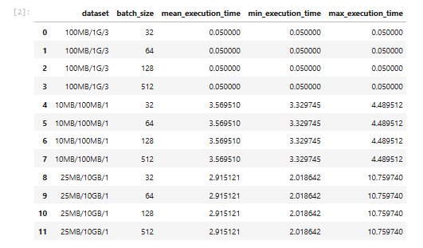
Batch Size Analysis
Execution time remained constant across batch sizes within the same dataset group:
Example: For 10MB/100MB/1, mean execution time about 3.57s for all batch sizes (32, 64, 128, 512).
In the 25MB/10GB/1 dataset, larger batch sizes did not reduce mean execution time, all configs about 2.92s.
Results for 100MB/1G/3 show execution time as 0.05s, likely due to a very small or cached workload (or misconfiguration).
No meaningful variance in min/max execution time across batch sizes, suggesting batch size had minimal impact on performance in the given context.
Implication: In distributed or parallel workflows, performance may be more sensitive to data chunking and I/O bottlenecks than batch size alone

Slide 13
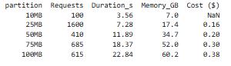
Cost Analysis
Costs scale with memory and request duration: larger partitions use more memory and run longer, increasing total cost.
Most cost-effective config: 25MB partitions
highest request count (1600) at only $0.16, due to balanced memory and execution time.
Highest cost: 100MB partitions at $0.38, driven by 60.2 GB of total memory usage and longer run time (22.84s).
Trade-off identified: 75MB offered near-peak throughput with moderate cost ($0.30) — good balance for scalable performance.
Optimizing partition size is key to minimizing cost while maintaining throughput.

Slide 14
Summary
Local CPU-based runs provided a baseline for batch performance, with batch size 128 offering the best throughput (~11.03 Mbps).
AWS Step Functions enabled massive scalability, with peak throughput reaching about 39 MB/s
Over 30× faster than local execution.
Cost-effective and high-performing setups were identified:
25MB partition: best for low-cost inference ($0.16 total).
75MB partition: optimal throughput-to-cost trade-off ($0.30).
Batch size had minimal impact on performance in AWS workflows, as shown in the Batch Size Analysis:
Execution times remained constant across batch sizes for the same dataset.
Performance bottlenecks were more influenced by data prefix size and I/O limitations.
Memory scaled predictably with input size (7 GB -71 GB), handled efficiently by serverless compute.
Overall, the project demonstrated that cloud-native inference pipelines can achieve low-latency, high-throughput, and cost-effective scalability when tuned with:
Proper partitioning
Concurrency (file limits)
Dataset design (chunk size)

